Slide 1
FCC3 246: CONCRETE MATERIALS
Lecture 5: AGGREGATES IN CONCRETE
Department of Civil & Construction Engineering
University of Nairobi
mwauras@uonbi.ac.ke

Slide 2
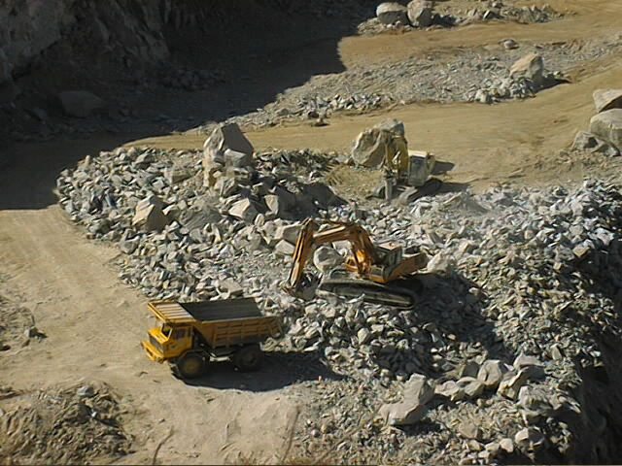
Aggregates in Concrete

Slide 3
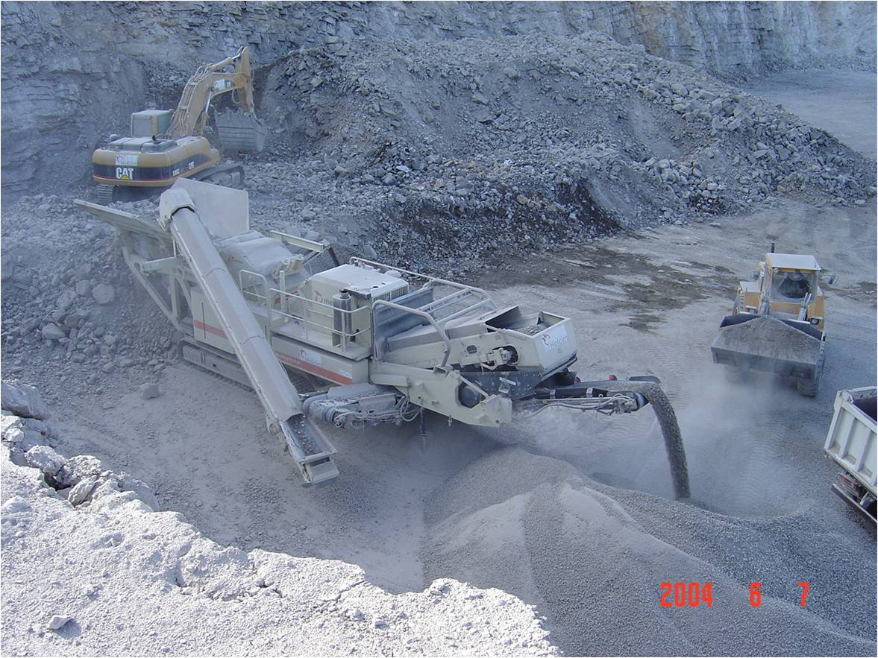
Natural Aggregate

Slide 4
What are Aggregates?
Filler materials used in manufacturing cement concrete are known as aggregates.
Sand, gravel, crushed rock and other filler materials are used as aggregates.
In CC, the volume occupied by aggregates is about 75% of the total volume of concrete.
Almost any material, provided it has the required strength, durability and soundness can be used as an aggregate for making concrete.
According to size, aggregates may be classified under two categories;
  COARSE Aggregate - Generally applied for aggregates that are greater than 1/4 inch
  FINE Aggregate - Generally applied for aggregates that are less than 1/4 inch

Slide 5
Introduction
Aggregates are inert
Normally derived from crushing rock
Aggregates make up:
  ¾ mass
  2/3 volume of concrete
By providing bulk, aggregates:
  Reduce cost
  Improve dimensional stability
There are two types:
  Fine aggregate
    Sand (-6mm)
  Coarse aggregate
    Stone (+6mm)

Slide 6

Why use aggregates in concrete?
Cement paste
Mortar
Concrete

Slide 7
Aggregate properties
Aggregates need to be:
Clean
Hard
Strong
Dimensionally stable
Durable rock particles
Free from clay
Free from organic materials
Chemically stable
Properly graded for size distribution
Without any deleterious material which may cause physical and chemical changes in the concrete

Slide 8
Deleterious substances:
Silt, clay and dust
Increased water demand
If it sticks on aggregates, it will reduce bond
If loose, it could reduce bleeding
Because aggregates make up roughly 75% of the volume of concrete, the structural strength of concrete is heavily dependent on the quality of its aggregates

Slide 9
Deleterious substances:
Organic impurities
Humus or loam, vegetable matter
Remove by washing
Retard the setting of fresh concrete and hardening of concrete
Aggregates should have clean, uncoated, properly shaped particles of strong, dense and durable materials
An aggregate that is dusty or muddy will contaminate the cement paste with inert particles that weaken it

Slide 10
Deleterious substances:
Chlorides
In sand from seashores or rivers and can:
  accelerate hardening
  increase corrosion
  cause efflorescence
Check levels in sand and water
Do not use calcium chloride as accelerator in reinforced concrete
Aggregates that contains any of a number of chemicals from sea salts to organic compounds can cause problems ranging from corrosion of reinforcing steel to retardartaion of the curing process and ultimate weakening of the concrete.

Slide 11
Characterize aggregates to:
Assess the suitability to make concrete
Compare different aggregates
Design a mix
Monitor the uniformity of supply

Slide 12
Important properties
Grading, bulk and relative density, shape, surface texture, strength, shrinkage, geological type and alkali reactivity
Influenced by:
Parent rock, geological exposure conditions, type of operation, equipment used for production

Slide 13
Production
Natural weathering:
Beach, river, dunes, pits
Base rock
Aggregate:
Sand and stone
Crushing:
Sand and stone:
Quartz, granite, dolerite

Slide 14
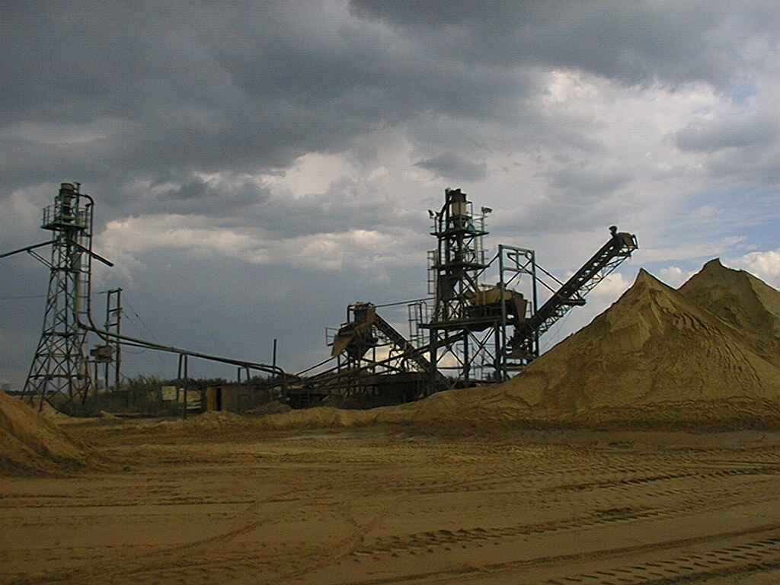
Sand washing plant. Washing removes excess clay and organic material (the organic floats off and is skimmed from the top).

Slide 15
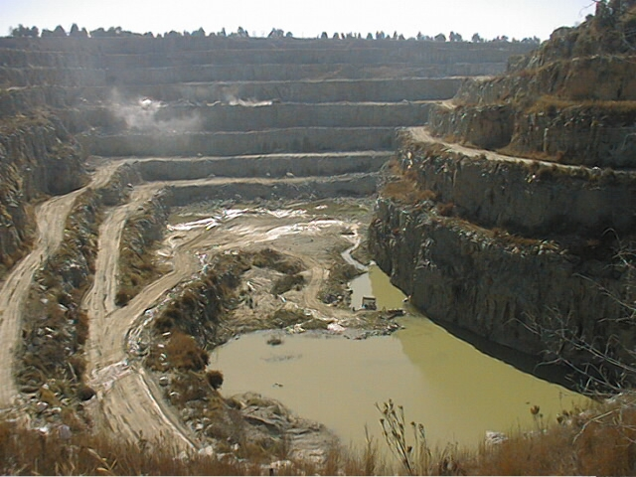
Granite quary.

Slide 16
Loading blasted rock into dump trucks for transport to the crusher.

Slide 17
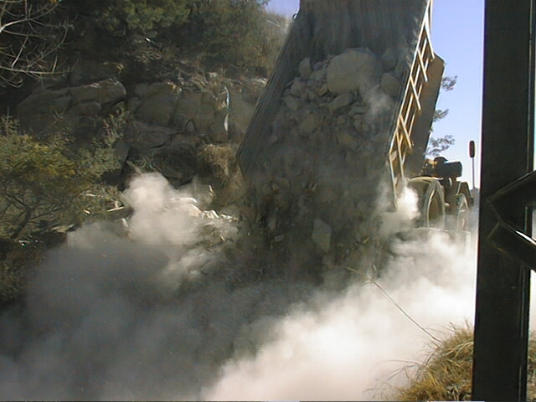
Rock is dumped onto a grizzly.

Slide 18
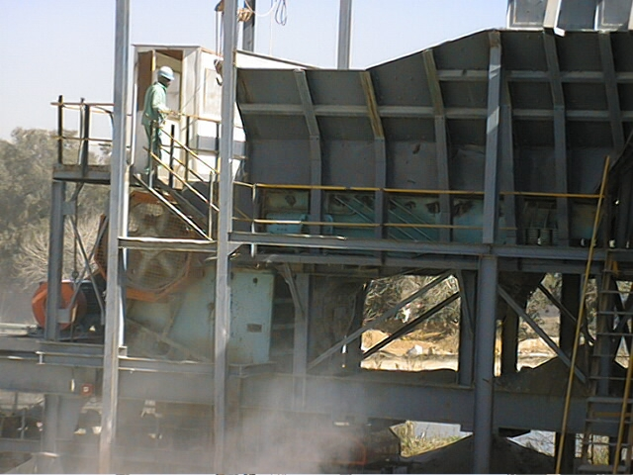
Boulders are crushed by a jaw crusher.

Slide 19
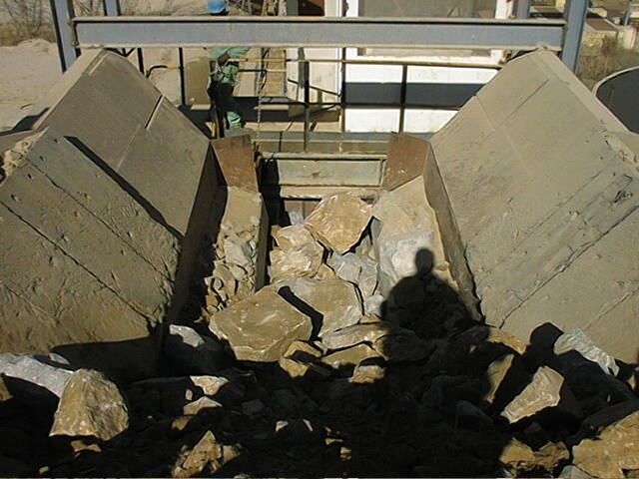
Feeding the jaw crusher.

Slide 20
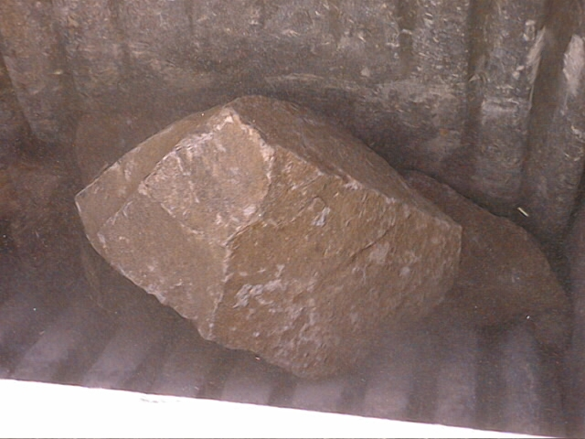
Boulders being crushed by the jaws of the jaw crusher.

Slide 21
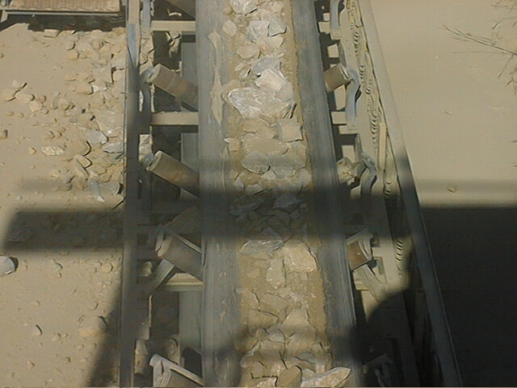
Rock fragments are conveyed away from the crusher and stockpiled.

Slide 22
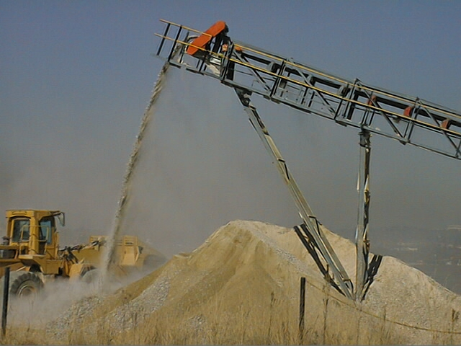
Stockpile

Slide 23
Types of Rock
Igneous rock: solidification of molten masses forced by pressure towards earth surface.
    granite, andesite, basalt, dolerite, gabbro, norite
Sedimentary rock: older rock broken down chemically or mechanically, particles deposited mostly under water and cemented together forming dense mass.
    Conglomerate, tillite, sandstone, shale, dolomite, limestone

Slide 24
Types of Rock
Metamorphic rock: rocks subjected to intense heat and/or pressure which changed the structure and chemical composition of the original rock
Two types of metamorphism:
  Thermal, heat with little pressure
  Dynamic, where pressure is the main factor
Metamorphic rocks may have been formed by either or both types.
    Quartzite, marble, slate, hornfels

Slide 25
Types of Aggregate
Natural aggregate consists of sands, gravels and crushed rock
Sands and gravels are products from water and wind erosion or glaciations
Crushed rock is obtained from quarries by drilling and blasting the rock face to maximize fragmentation
Blasted fragments are crushed and passed through a series of screens to produce particle size fractions required.

Slide 26
Production and processing
Main methods of extracting sand and gravel:
Wet
  Extraction below water table. Extracted by suction dredging or floating grab dredgers
Dry
  Extracted by dragline or front-end loader
Marine
  Extracted with large self-propelled seagoing barges
Processing includes crushing, screening and washing

Slide 27
Aggregate Properties affecting Concrete
Particle size
Grading
Shape & surface texture
Bulk density
Absorption
Relative density
Strength

Slide 28
Aggregate Characteristics
A number of laboratory tests are used to assess the various qualities of aggregates
Size distribution of aggregate particles is important because a range of sizes must be included and properly proportioned in each concrete mix to achieve close packing of the particles
A concrete aggregate is graded for size by passing a sample of it through a standard assortment of sieves with diminishing mesh spacings.
Other important characteristics of aggregates which may affect the performance of concrete are shape of the particles, surface texture, porosity, adsorption and presence or absence of deleterious materials in the aggregates.

Slide 29
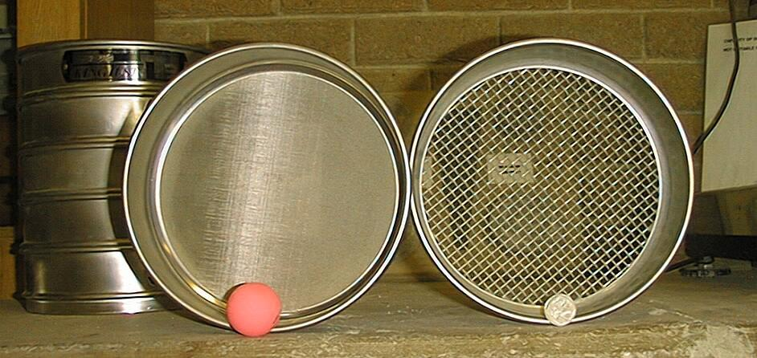
Fine aggregate
  > 90% pass through 4mm sieve
  > 90% retained on 63 micron
Coarse aggregate
  Larger than 6mm

Slide 30
Grading
Distribution of particle sizes very important for workability and durability
Grading analysis can be used to:
  Determine proportions in trial mixes
  Ensure consistent properties of delivered material
Deficiency or surplus of a size (single sized) will give poor workability
Fineness Modulus (FM) is a measure of average particle size

Slide 31
Grading
Sieve sizes
  Because aggregates are classified in terms of their minimum size d and maximum size D such as 6/20 for 20 mm down and 0/6 for sand, sieve sizes are also identified in terms of d and D
Mid-range sieve
  A specific sieve, known as the mid-range sieve, may be required for graded (as opposed to single-sized) coarse aggregates

Slide 32
Sieving
After washing and oven drying the aggregate test sample pour it carefully into the top sieve and fit the lid.
Shake the column either by hand or mechanically.
Remove the top sieve, place it on a sieve pan and fit a lid on top.
Shake the sieve and weigh the material retained on it.
Return the weighed sample to the sieve, continue shaking it for another 1 minute
and then reweigh the material retained.
When the retained material is constant to 1.0% after one minute sieving, record

Slide 33
Shape & Surface Texture
Both shape and surface texture influence strength and water requirement
Bond is improved with rough texture
Rough, angular particles has higher water requirement
Smooth and round particles better workability, require less water, but lower bond strength

Slide 34
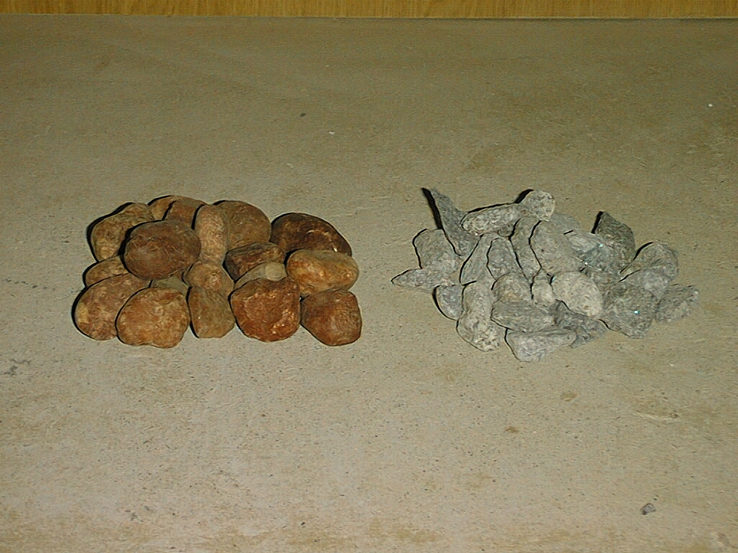
Shape & surface texture
Increasing strength
Increasing water requirement
33% voids
45% voids
=> Angularity number = % voids - 33

Slide 35
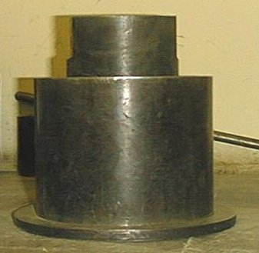
Strength of Aggregates
Little effect on concrete with strength up to 40 MPa
No relation between concrete and aggregate strengths
Measured indirectly
  Max. ACV 29% breakdown
  10% FACT (force to cause 10% breakdown) to be 110 kN for abrasion resistance and structural reinforced concrete-

Slide 36
Site tests
Grading
  To determine size distribution
Moisture content
  To enable an estimate to be made of the quantity of water contained within aggregate and to adjust the mix design accordingly
Visual examination
  Inspect aggregate to recognize changes in size, grading, shape, surface texture, cleanliness, colour and staining.

Slide 37
Moisture content
Standard (oven-drying) method
  Weigh the sample containing the moisture (A)
  Dry the sample in a ventilated oven (at 105±5°C) or a microwave oven, but do not use direct heat
  Allow to cool for 45±5 min and weigh the dry mass (B)
  Calculate:
A - B
  MC =
  X 100
B

Slide 38
Representative sample
Take increments from positions evenly distributed over whole surface of the heap, removing at each position the top 150mm before digging in the scoop
Reduce the sample using coning and quartering or use a riffle box
The riffle box divides the sample in two portions
One is discarded and the other portion passed through again. Repeat this process until required size

Slide 39
Field settling test
Give approximate guide to amount of fines in natural sands, but not coarse aggregate or crushed-rock sand
Place 50ml of 1% salt solution (2 teaspoonsful per liter in 250ml measuring cylinder
Add sand until level of sand is at 100ml mark
Add more solution to 150ml mark
Shake vigorously, allow to settle for 3 hours
Thickness of layer of fines above sand is measured and expressed as percentage of height of sand below the layer.

Slide 40
Flakiness index test
Consists of two sieving operations
First using test sieve, sample is separated into various particle size fractions di/Di
Each particle size faction di/Di is then sieved using bar sieves with parallel slots of width Di/2
Sieving is done manually and is complete when retained mass does not change by more than 1% during 1min sieving operation
Overall flakiness index is calculated as total mass of particles passing bar sieves expressed as percentage of total dry mass of particles tested.

Slide 41
Shape index test
Individual particles are classified on basis of ratio of their length (L) to thickness (E) using particle slide gauge
Shape index is calculated as mass of particles with ratio L/E > 3 expressed as a percentage of total dry mass of particles tested
If L/E > 3, particles are classified as non-cubical
Do test on each particle size fraction di/Di where Di ≤ 2 di.

Slide 42
Storage of Aggregates in a Construction Site
An area should be demarcated and preferably fenced for storage of aggregates in the construction site
Proper material storage will help in reducing aggregates’ wastage that occurs due to run-off water during rains and unnecessary spread over a larger area of the site
Securing aggregates on site reduces risk of theft
Storage should be such that it reduces obstruction to traffic and pedestrians
Aggregates must be stored in a clean area free of loam, clay and vegetable matter because these foreign particles prevent cement paste from properly binding aggregate particles together.

Slide 43
Storage of Aggregates in a Construction Site
Concrete that contains the above objectionable materials will be porous, have low resistance to weathering and have low strength. It could also develop surface defects such as pop-outs
Storage area needs to be clearly shown on the site plan
Storage area needs to be well allocated to have vehicular access
If no space is available on site for storage, the nearest available space is a near-by empty site which can be used with written permission from the site owner
The storage area should not be on the road or pavement or on any other community space

Slide 44
Storage of Aggregates in a Construction Site
The storage space should be clearly defined on site with temporary enclosures located for easy vehicular access
The storage enclosure should be built such that sand and coarse aggregate do not spread beyond the allocated space for their storage
If enclosure cannot be built due to space restrictions, aggregate should be stored in large jutes or gunny bags on site
A last resort on space restrictions is to order ready-made concrete in bulk delivered by trucks specially designed for that purpose

Slide 45

Feedback
feedback

